Slide 1
BANK DATA ANALYSIS
By:-
Group – A
Deepali Jain, Tripti Rastogi and Disha
(GIC_OND21_PYSPARK_1)

Slide 2
Project Understanding
Problem Statement
Data Understanding
Use Cases
Solution
PySpark
Why PySpark
SparkSQL
Flowchart
Packages Used
Data Analysis

Slide 3
Problem Statement
Analyse marketing data for call campaign by Bank
Description :
Your client―a Portuguese banking institution—ran a marketing campaign to convince potential customers to invest in bank term deposit. Information related to direct marketing campaigns of the bank are as follows. The marketing campaigns were based on phone calls. Often, the same customer was contacted more than once through phone, in order to assess if they would want to subscribe to the bank term deposit or not.
Source of data :
Kaggle.com

Slide 4
Data Understanding
1 - age
2 - job
3 - marital
4 - education
5 – default (credit in default)
6 – balance
7 – housing (housing loan)
8 – loan (personal loan)
9 - contact
10 -day
11 - month
12 - duration
13 - campaign
14 - pdays
15 - previous
16 - poutcome
17 - y (subscription for deposit)

Slide 5
Use Cases
1. Load data and create Spark data frame
2. A. Give marketing success rate. (No. of people subscribed / total no. of entries)
B. Give marketing failure rate
3. Maximum, Mean, and Minimum age of targeted customer
4. Check quality of customers by checking average balance, median balance of customers
5. Check if age matters in marketing subscription for deposit
6. Check if marital status mattered for subscription to deposit.
7. Check if age and marital status together mattered for subscription to deposit scheme
8. Check how many customers have taken the subscription when called once.
9. Check how many unemployed customers have not taken the subscription.

Slide 6
Solution
The data size is huge(45211 records), so we have used Spark (particularly PySpark) to help the Marketing Team get answers for the previously mentioned problems.

Slide 7

PySpark is a Spark library written in Python to run Python application using Apache Spark capabilities, using PySpark we can run applications parallelly on the distributed cluster (multiple nodes).
In other words, PySpark is a Python API for Apache Spark. Apache Spark is an analytical processing engine for large scale powerful distributed data processing and machine learning applications.

Slide 8
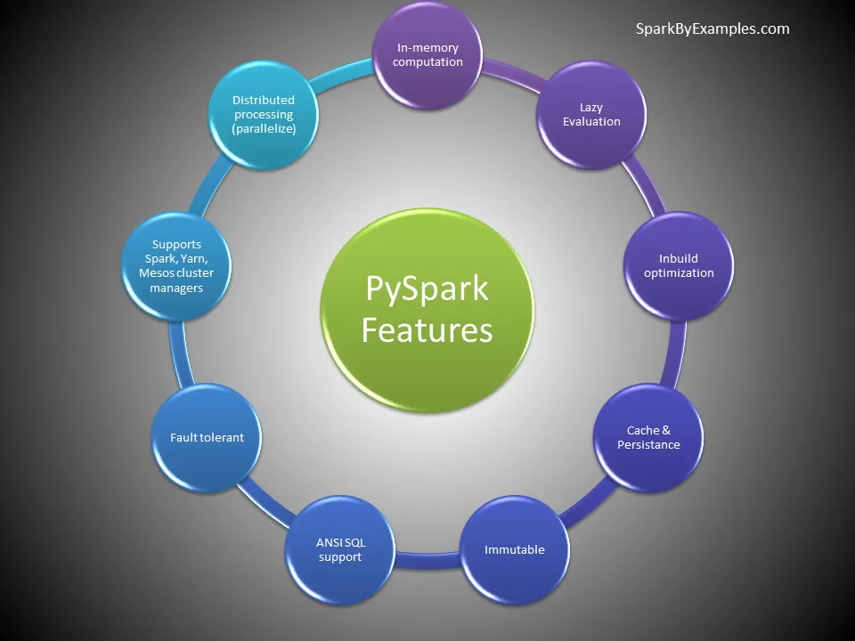
Why PySpark ?
Performance
Processing
Scalability
Security
Machine Learning

Slide 9

Spark SQL is a Spark module for structured data processing. It provides a programming abstraction called DataFrames and can also act as a distributed SQL query engine.

Slide 10
Flowchart
Bank.csv
Or
Bank.txt
Make .py file
Create Spark DF by reading source file.
Data Analysis
Run script file by pyspark < filename

Slide 11
Packages Import
SparkContext
SQLContext
udf
col

Slide 12
Data Analysis

Slide 13
References
https://sparkbyexamples.com/
https://home.apache.org/~pwendell/spark-nightly/spark-branch-2.0-docs/latest/
https://www.javatpoint.com/apache-spark-architecture

Slide 14
THANK YOU

